Slide 1
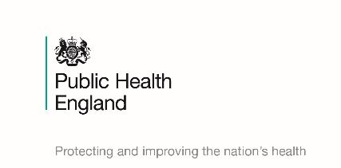
Health Inequalities, Devolution and the North East
Professor Peter Kelly
Centre Director - Public Health England North East
Fuse Quarterly Research Meeting
Equal North: how can we reduce health inequalities in the North?
12 January 2017

Slide 2
Health inequalities
Health inequalities are differences in health status or in the distribution of health determinants between different population groups; driven by -
Structural issues – the ‘causes of the causes’ for example, differences in levels of income and employment experienced by different groups
2. Unhealthy behaviours such as smoking, harmful drinking, poor diet and a lack of physical activity. Certain groups are at increased risk of unhealthy behaviours and this contributes to inequalities in health
3. Unequal access to or experience of services

Slide 3
We have made progress in the North East
Teenage pregnancies
Smoking prevalence
Alcohol related harm
Mortality from cardiovascular disease
Better Health at Work
Making Every Contact Count

Slide 4
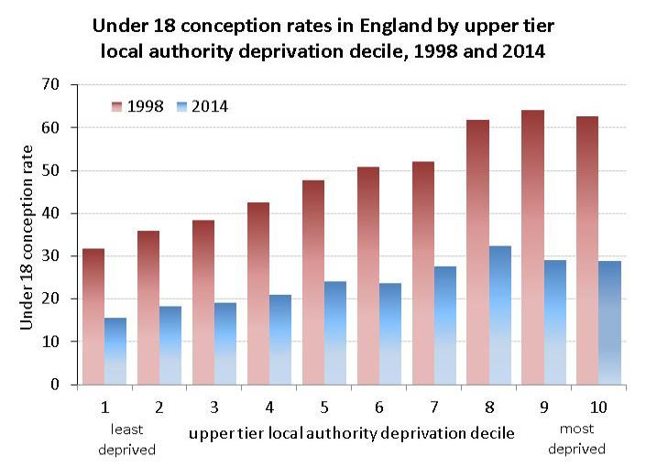
Inequalities in under 18 conceptions, 1998 and 2014
Source: Public Health England, Public Health Outcomes Framework Tool at www.phoutcomes.info, rates are per 1,000 females 15-17 years of age

Slide 5
A Fresh Exemplar
Smoking has declined by more than a third from 2005 to 2014, with the biggest decline of any region in England as shown below. From 1 in 3 adults regularly smoking in 2005, it is now down to 1 in 5 (19.9%). This is 165,000 fewer smokers.
Notes:
Since the programme was introduced in 2005 the following has been achieved smoking has declined by more than a third from 2005 to 2014, with the biggest decline of any region in England from 1 in 3 adults regularly smoking in 2005, it is now down to 1 in 5 (19.9%). This is 165,000 fewer smokers. Smoking related mortality in the NE is declining faster than the national average.
The last decade has also seen the NE arguably lead the way within the UK on how to take a successful approach at addressing tobacco. This has been driven through: an effective partnership approach (with all localities and also with other regions and national partners like ASH, with Fresh being one of the five permanent core members to the Smokefree Action Coalition) developing and delivering a unified strategy; implementing a comprehensive evidence-based tobacco control package; proactive and reactive media work; building positive public opinion; building cross-party political support; and consistently pushing a working together – “it`s everyone`s business”- philosophy underneath the Fresh umbrella (brand).
Smoking related mortality in the NE has been declining faster than the national average: Mortality rates from selected smoking related diseases. E.g. CHD down by 42.5% since 2005 in the NE compared with 36% in England.

Slide 6
Hospital Admissions by Region
Area | 2011/12-2014/15
North East | -5.1%
North West | 6.1%
Yorkshire & Humber | 9.6%
East Midlands | 8.4%
West Midlands | 9.3%
East of England | 6.5%
London | 4.2%
South East | 6.1%
South West | 4.7%
England | 5.8%

Slide 7
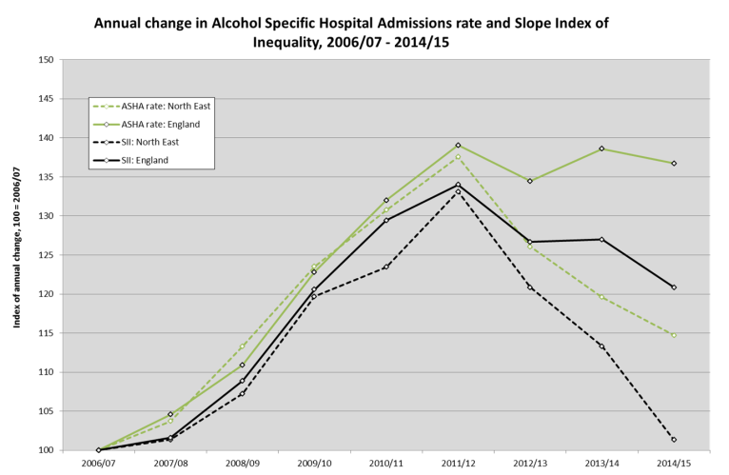
Alcohol and its impact on health inequalities: continued
Notes:
NEW SLIDE PENDING WITH ACCOMPANING TEXT

Slide 8
Notes:
Similar position on CVD – have fallen by over 50% in the last 15 years.

Slide 9

An evidence-based, effective mechanism for engaging with all sectors and size of employers
More than 320 workplaces participated in 2016 with a potential reach of around 200,000 employees
Demonstrable success in achieving benefits for employers and employees which impact positively on the North East economy

Slide 10
Making Every Contact Count (MECC)
North East MECC Conference held on 9 September 2016 showcasing examples of MECC including:
      Fire and Rescue Service
      NHS Foundation Trusts
      Local Authorities
      Pharmacies
    North East MECC Steering Group to develop a standard approach
      Standardised training
      Branding
      Embedding MECC across all agenda’s
      Measurable – recognition that this was a challenge

Slide 11
Health inequalities
Health inequalities are differences in health status or in the distribution of health determinants between different population groups; driven by -
Structural issues – the ‘causes of the causes’ for example, differences in levels of income and employment experienced by different groups
2. Unhealthy behaviours such as smoking, harmful drinking, poor diet and a lack of physical activity. Certain groups are at increased risk of unhealthy behaviours and this contributes to inequalities in health
3. Unequal access to or experience of services

Slide 12


Consultation launched October 2007
First edition published February 2008
Notes:
There was a 3 month consultation period Oct-Dec 2007 with wide engagement from the statutory, business, community and voluntary sectors.

Slide 13
  Vision
  The North East will have the best and fairest health and well-being, and will be recognised for its outstanding and sustainable quality of life
Notes:
The first edition of Better Health Fairer Health published in February 2008, was an ambitious strategy for health and well-being, aiming to make the health of the North East the best of any in the country over the next 25 years
13

Slide 14
Overview
Notes:
5YFV stated that a combination of growing demand, no further annual efficiencies and flat real terms funding would create a £30bn gap by 2020/21. Stevens has asked for £8bn and has stated that the other £22bn will be met through transformation.
Both NHS planning and BCF planning require a shared vision of how the local system will survive and be sustainable.
The 5YFV:
Outlined what the NHS needs by way of investment
Engaging communities
New models of care
Making best use of the workforce
But most importantly - getting serious about prevention
We all know that prevention is the right thing to do, but we know that committing to prevention is very difficult to do.
The North East has strong acute health services and increases in life expectancy along with reductions in smoking have been greater than elsewhere in the UK. But there is no hiding from the fact that health outcomes are poor and that health inequalities within the region are far too great. The recent NECA Commission on Health and Social Care outlined the key things NECA region should be doing to tackle the ill health and inequality gaps we have today. Although the report was written for the NECA area, the lessons are much more broad and address many of the challenges the north east faces as a whole.
There are many important things in the report that we must consider much more broadly as a system – particularly the link between health and wealth, and the cycle of deprivation and worklessness and the impacts on health that we must address.
However, much as the NHS needs to be around the table of tackling the bigger issues of deprivation and ill health in the north east, it also has a very specific role it could and should play in prevention. This more specific role has been laid out in the STPs across the patch, but it broadly includes:
The NHS’s role as a commissioner – we should be buying the right services that focus on prevention and provide the greatest value – this will also be picked up in presentations on Value-Based Clinical Commissioning and NHS Rightcare,
The NHS’s role as a service provider – the vast reach of the NHS, its workforce and its facilities means that we should be ensuring that they system is as geared towards prevention as possible,
We want to explore this today. I am going to outline three key things we should be doing as a health and care system that will reap massive rewards in the short, medium and long term for the health and care system. I am going to lay the evidence-based case out for all three, and then you – as a collective, on your tables are going to tell me why it can’t be done…

Slide 15
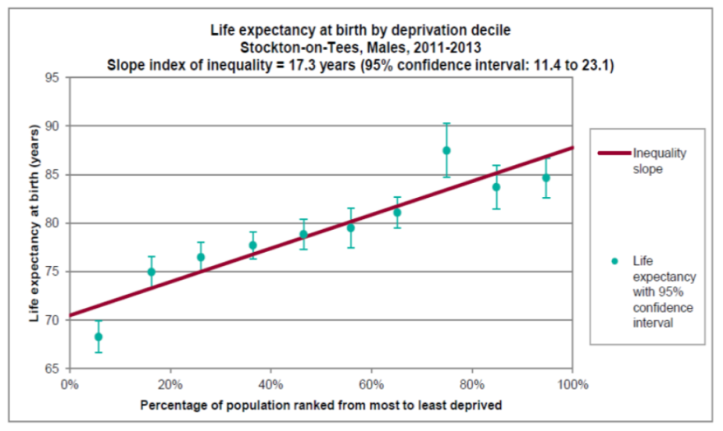
Life expectancy at birth by deprivation decile
Extract from Investigating the life expectancy gap in Stockton on Tees by Andy Graham, Public Health Registrar

Slide 16
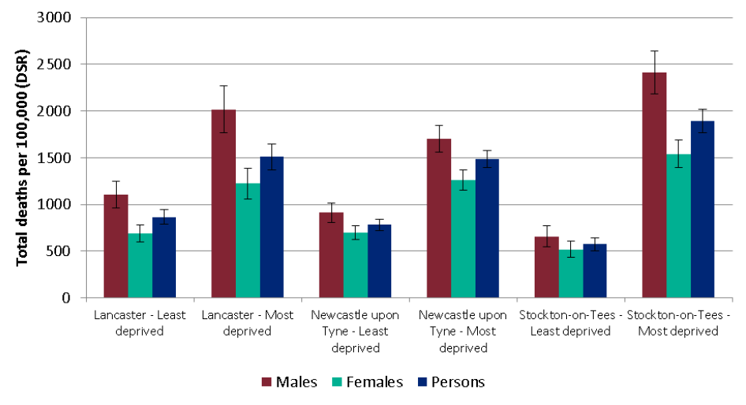
Age-standardised mortality rates for all deaths per 100,000 population, 2012-14
Extract from Investigating the life expectancy gap in Stockton on Tees by Andy Graham, Public Health Registrar

Slide 17
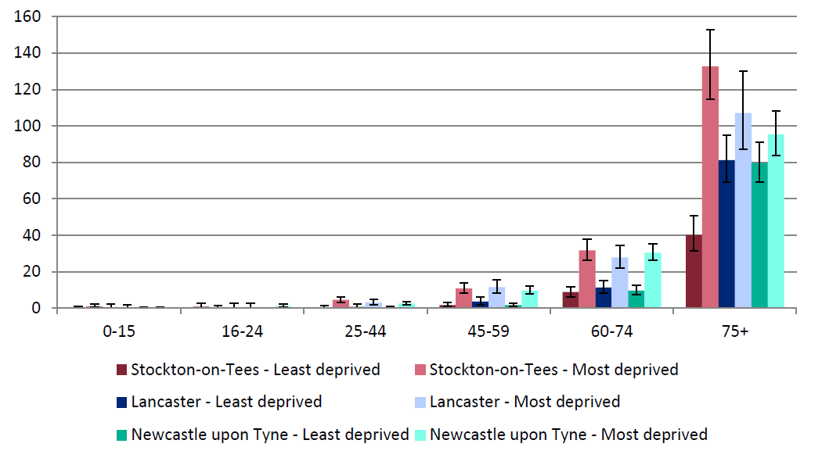
Age-specific crude mortality rates for most and least deprived deciles in three local authorities for males per 1,000 population, 2012-14
Extract from Investigating the life expectancy gap in Stockton on Tees by Andy Graham, Public Health Registrar

Slide 18
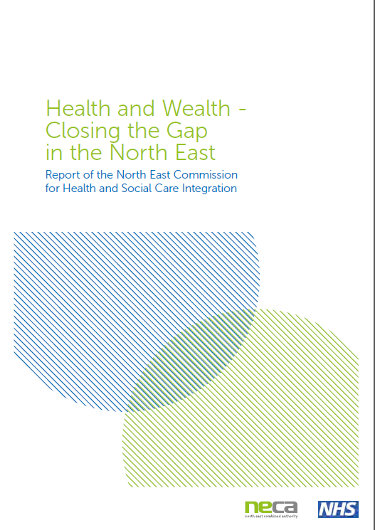
North East Commission for Health and Social Care Integration
Closing the healthy life expectancy gap with the rest of the UK over the next decade would add 400,000
additional years of active, healthy life for the people of the region
Duncan Selbie,
Chief Executive of Public Health England
and Chair of the Commission

Slide 19
Health and Wealth – Closing the gap in the North East
Despite increases in life expectancy, the health and wellbeing gap with the rest of the UK and health inequalities within the region remain stubbornly high
Poor population health leads to overuse of health and social services, resulting in a system over-focussed on the treatment of ill health at the expense of preventing it
It also reduces productivity and hampers economic growth, entrenching the income inequalities which contribute to poor health

Slide 20
Health and Wealth – 10 recommendations
1 Set an ambition to radically increase spending on prevention
8 Leaders within organisations will need to look beyond the interests of their own organisations to drive improvement in wellbeing outcomes across NECA
9 Governance should be established at NECA level to drive forward implementations of these recommendations

Slide 21
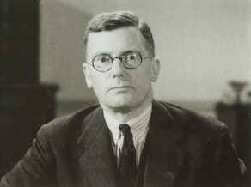

Slide 22


Slide 23
Dr George Mcgonigle
Chief Medical Officer, Stockton Council 1924-1939
“poverty, not ignorance, was the cause of morbidity and mortality amongst the poor and this poverty was not the fault of individual families but of a society that provided inadequate wages and welfare benefits”

Slide 24
Summary
Whilst both are important, focusing upon lifestyle issues and/or equality of access to services, without also closing the wealth gap, will not solve the health inequality problem.
To make progress, we should always ask the question:
What is the impact of this policy upon health inequalities?

